Slide 1
Extremophiles

Slide 2
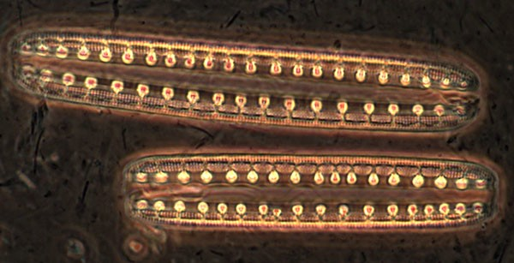
Life is found in some extreme environments on Earth: places where it's hot, cold, dark, acidic, salty or there's no oxygen.
Organisms that live in particularly tough environments are called extremophiles.

Slide 3
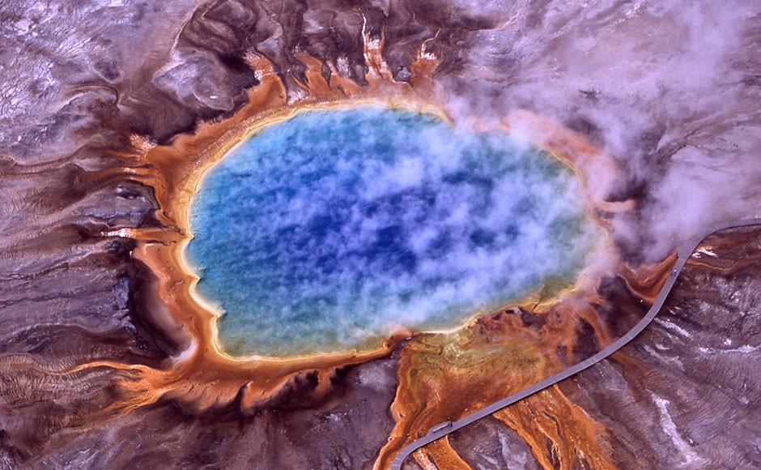
Grand Prismatic Spring, Yellowstone National Park

Slide 4
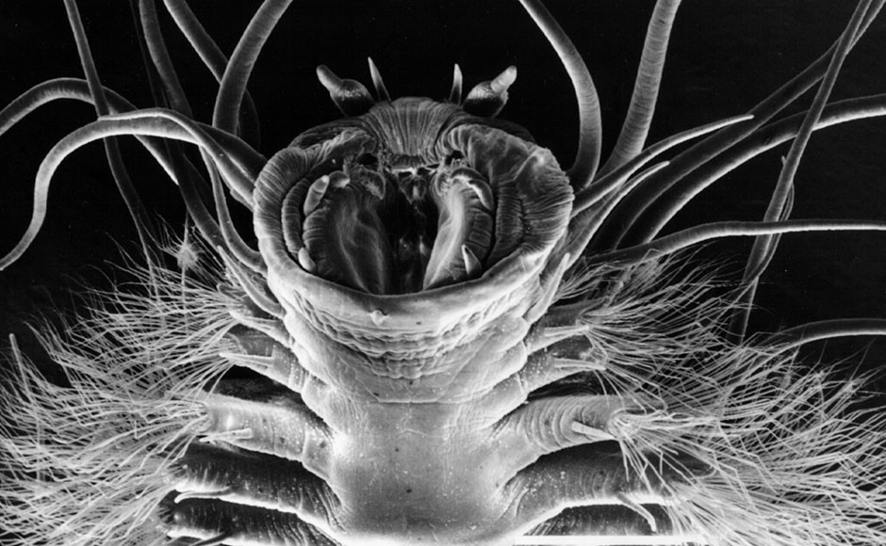
methane ice worm

Slide 5
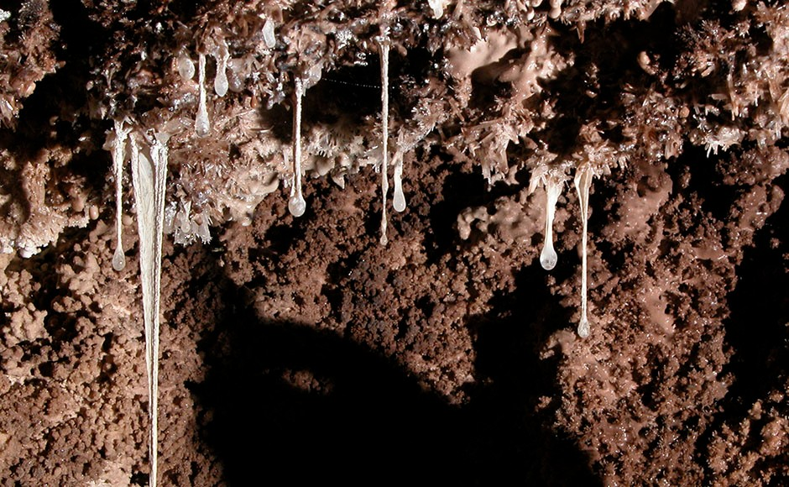
snottite

Slide 6
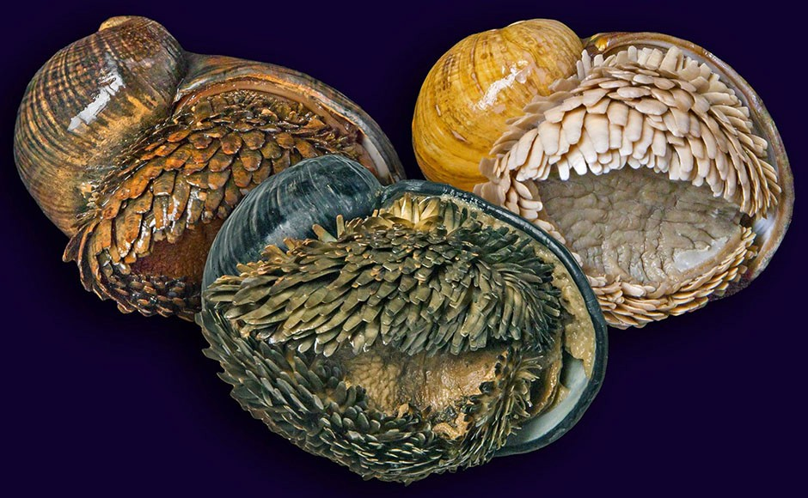
scaly-foot gastropod

Slide 7
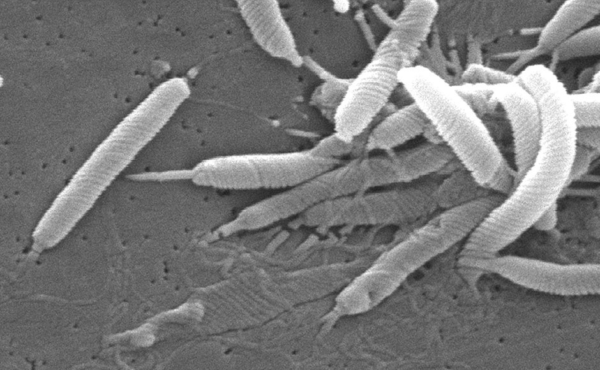
Helicobacteria pylori

Slide 8
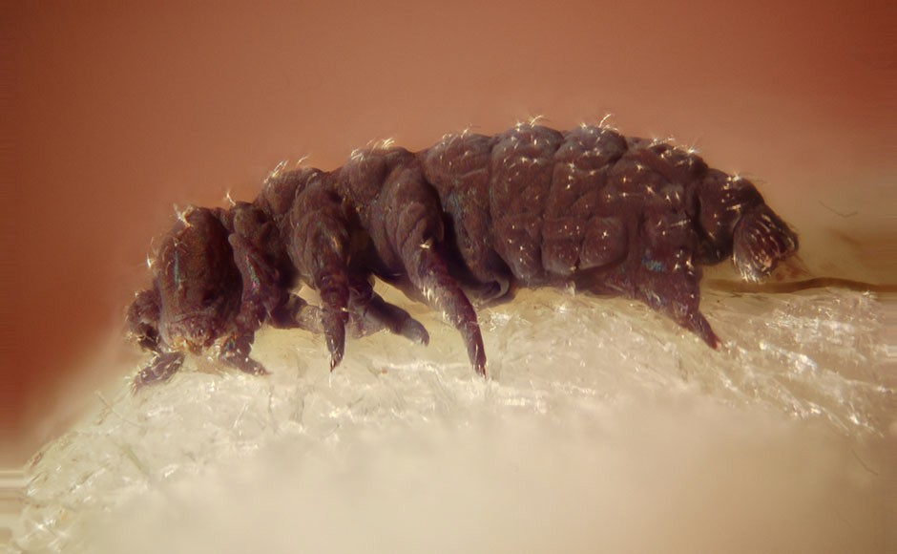
water bear (Tardigrade)

Slide 9
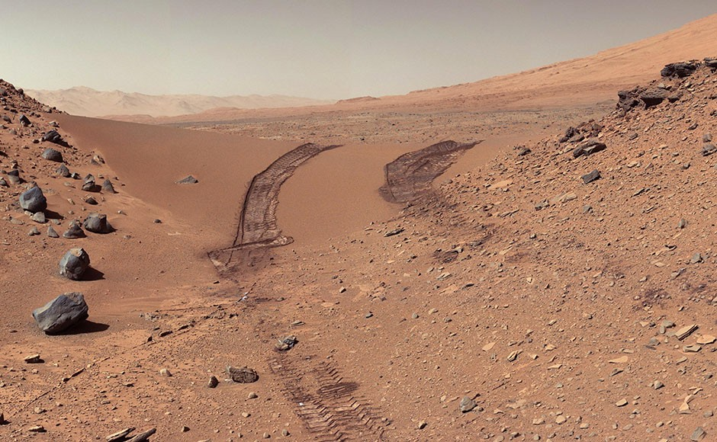
Could there be life on other planets, such as Mars?

Slide 10
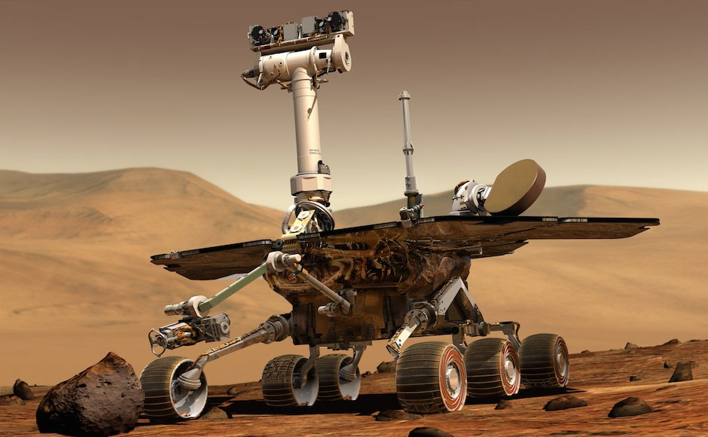
How could we find out?

Slide 11

Some scientists believe Jupiter's moons are the best place to look for life in the Solar System.

Slide 12
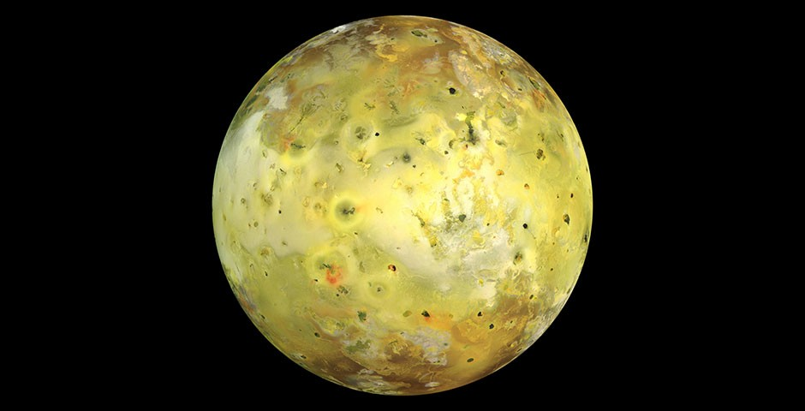
Io

Slide 13
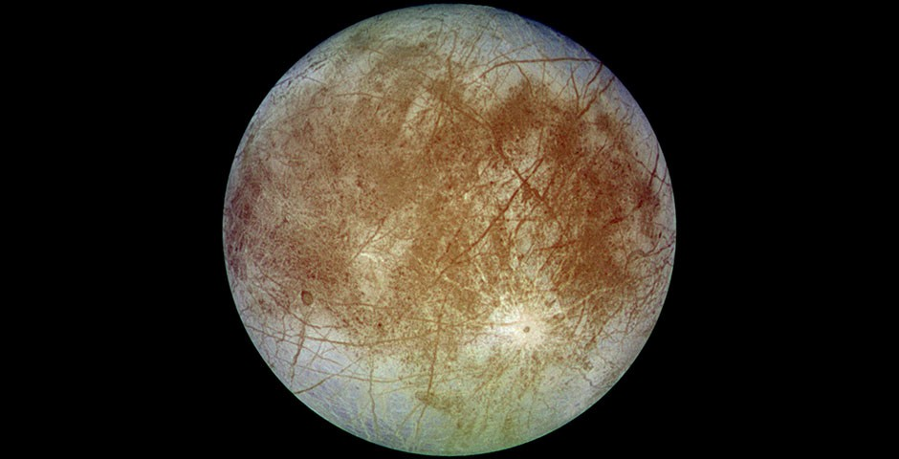
Europa

Slide 14
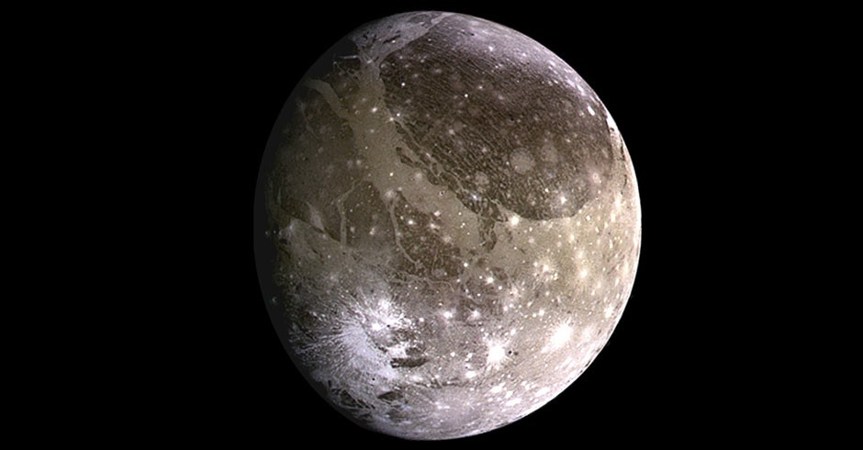
Ganymede

Slide 15
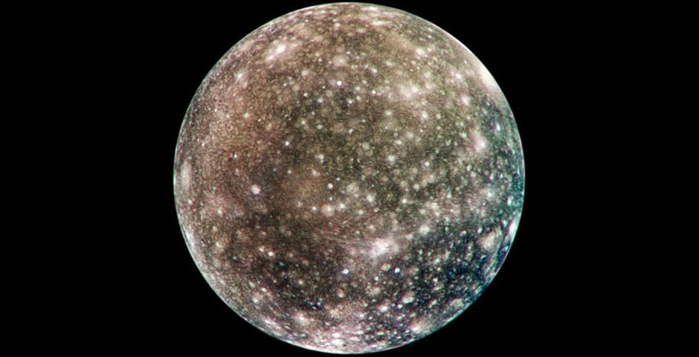
Callisto

Slide 16
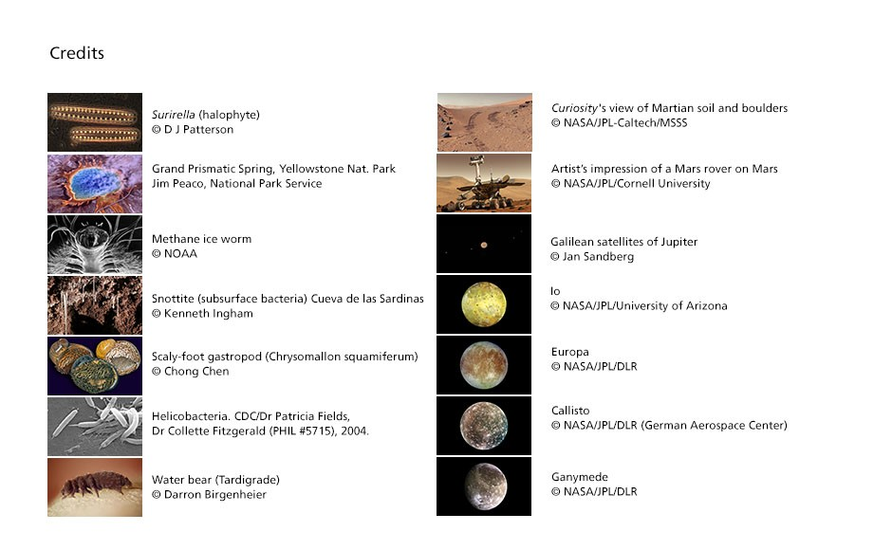

Slide 17
