Slide 1



Assessment Submission Reminder!
ACADEMIC MISCONDUCT
Academic Integrity
Honesty
Trust
Fairness
Respect
Responsibility
Is it your own academic Work?

Slide 2
345
Notes:
72 Sem 1; 78 Sem 2

Slide 3
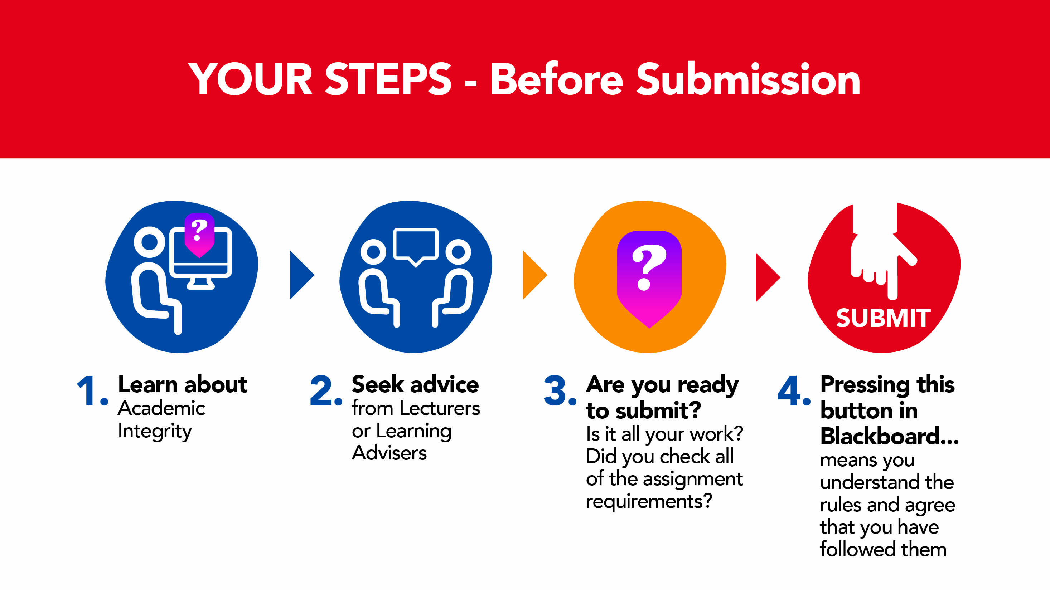




1. Learn
about Academic Integrity
2. Seek Advice
from your lecturers or tutors or learning skills advisors
3. Are you ready to submit? Is it all your work? Did you check all assignment requirements?
4. Pressing this button in LMS means
that you understand the rules and agree to follow them

Slide 4
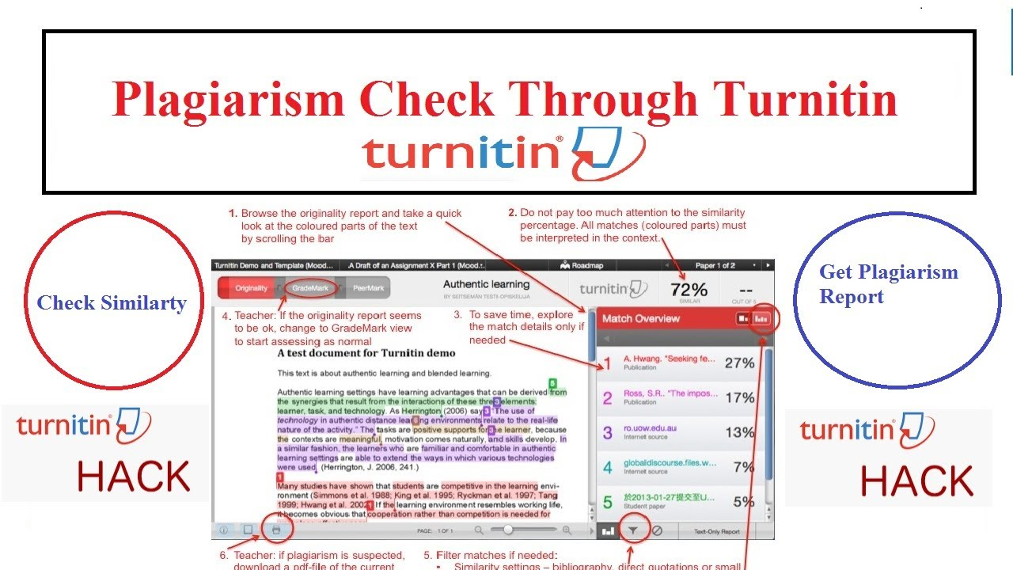
The FINAL
Checks

Slide 5
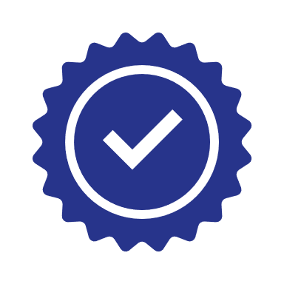



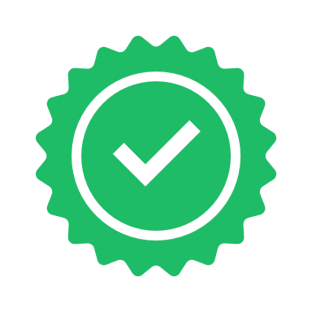

Steps Post-Submission
Plagiarism check
Collusion check
Contract cheating
check
OR
1. Assignment received
No Issues
Assignment Marked
2. Academic integrity checks completed
Misconduct identified
Investigation commences

Slide 6

Why is checking so important?
We Assume Students Know the Rules: it is assumed that all students, regardless of where they are from, how long since they last studied, or if they are in their first semester at university, have read the UWA rules in relation to Academic Integrity and Academic Misconduct. Subsequently ‘I do not know what academic integrity is, is not considered a reasonable excuse for breaches of Academic Integrity.
We Assume You Have Checked It: when undertaking an Academic Misconduct investigation, we assume that not only do students know the rules, but that they have thoroughly checked their own work against those rules prior to submitting their work.
Better Late Than Never: sometimes it can take a bit longer to thoroughly check your assignment in order to avoid breaches of Academic Integrity. It is better to submit your assignment a bit late and receive some late penalties rather than rush to submit by the deadline and end up involved in an Academic Misconduct investigation.

Slide 7

Conclusion
Academic Misconduct does not happen by accident. It typically occurs as a result of poor planning and/or choices made early in the assignment process.
During Academic Misconduct investigations, students will often rationalise why they felt it necessary to take the steps that led them to a misconduct investigation, and while the investigator may sympathise, such rationalisations have no impact on the final misconduct finding.
The best and only way to avoid the stress and marks impact of breaching Academic Integrity rules is simply not to do it in the first place.
Remember, check your work, ask your lecturer or tutor,
speak to a learning adviser, but only before you submit
your work, not after.

